Slide 1
ELEC1200: A System View of Communications: from Signals to Packets Lecture 14
Time-Frequency Analysis
Analyzing sounds as a sequence of frames
Spectrogram
Lossy Encoding
MP3 encoding

Slide 2
Time-Frequency Analysis
For many complex signals (like speech, music and other sounds), short segments are well described by a sinusoidal representation with a few important frequency components, but long segments are not.
Time-frequency analysis refers to the analysis of how short-term frequency content changes over time.
The spectrogram of a signal is a picture of how its amplitude spectrum of a signal changes over time.
The vertical axis represents frequency
The horizontal axis represents time
The image color represents Fourier amplitude
red = large amplitude, blue = small amplitude

Slide 3
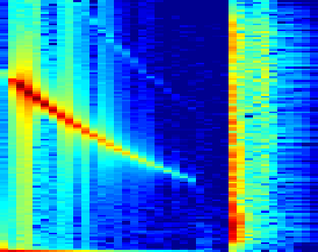
Spectrogram Example
35
amplitude spectrum
35
amplitude spectrum
35
amplitude spectrum
loud
high frequency
quiet
lower frequency
loud
many frequencies
30
30
30
25
25
25
20
20
20
15
15
15
10
10
10
5
5
5
0
0
1000
2000
3000
4000
0
0
1000
2000
3000
4000
0
0
1000
2000
3000
4000
frequency (Hz)
frequency (Hz)
frequency (Hz)
4000
3500
blue = quiet
red = loud
3000
2500
frequency (Hz)
2000
1500
1000
500
0
5
10
15
20
25
30
35
frame number

Slide 4
Computation of the Spectrogram
Divide the signal into a set of frames, typically about 20-50ms long.
Compute the amplitude spectrum of each frame.
This gives you a two dimensional array of real numbers, indexed by frame number and frequency index.
Plot this as an image.
It is generally more informative to plot the logarithm of the amplitude, as this compresses large amplitudes allowing the smaller details to show up.
To avoid problems at zero, apply a small positive floor to the values (i.e. replace each amplitude by P if it is smaller than P, where P is small).
frame

Slide 5
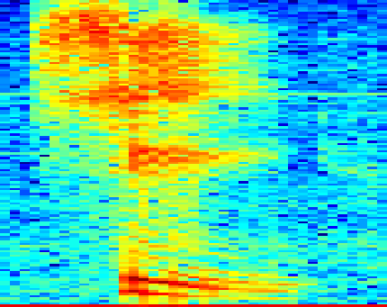
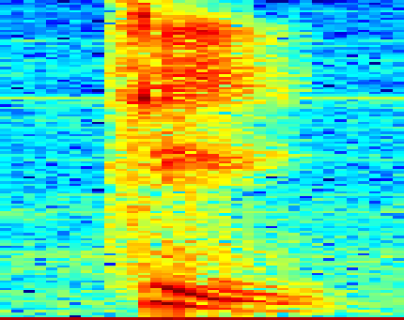
Speech Spectrogram
spectrogram of “she”
can you guess what word this is?
4000
4000
3500
3500
3000
3000
2500
2500
frequency (Hz)
frequency (Hz)
2000
2000
1500
1500
1000
1000
500
500
0
0
5
10
15
20
25
30
35
5
10
15
20
25
30
35
frame number
frame number

Slide 6
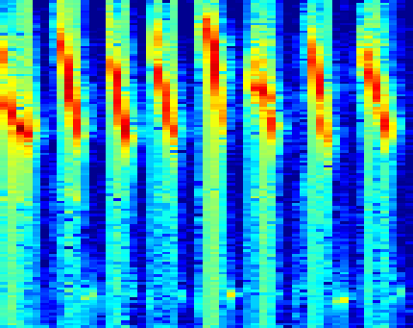
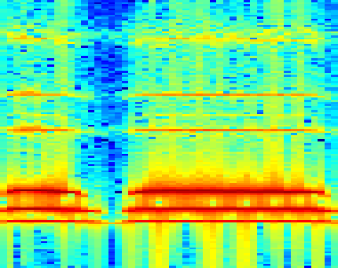
Train Whistle vs. Bird Chirps
Can you figure out which is which?
spectrogram
spectrogram
4000
4000
3500
3500
3000
3000
2500
2500
frequency (Hz)
frequency (Hz)
2000
2000
1500
1500
1000
1000
500
500
0
0
10
20
30
40
50
10
20
30
40
50
frame number
frame number

Slide 7
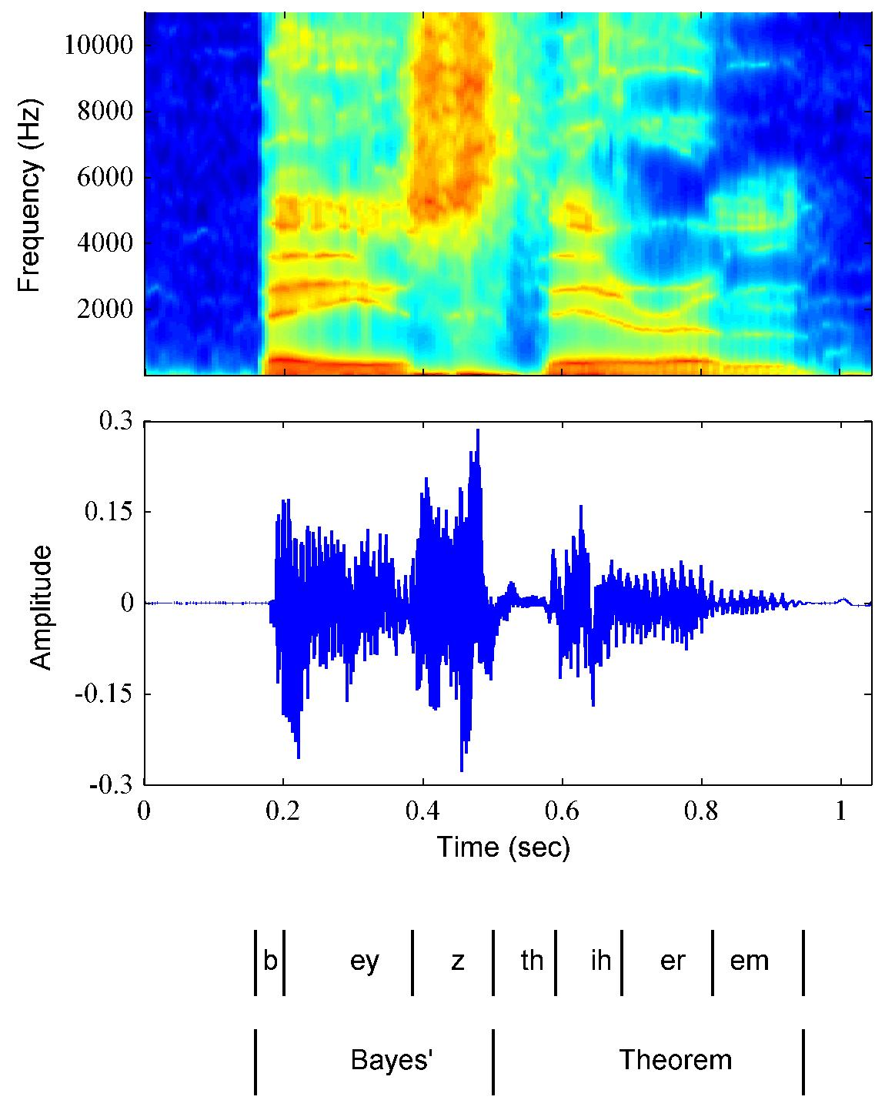
Speech Data
red = high energy
blue = low energy
Characteristics
Recent measurements more informative in predicting the future than those in the distant past.
At each point in time, different sounds (phonemes) may be pronounced.
Different phonemes have different spectral content.
phonemes

Slide 8
Encoding and Decoding
Source
Encoding
Source
Decoding
bits_{IN}
Store/Retrieve
Transmit/Receive
bits_{OUT}
Encoding
Auditory signal (from a recording) is coded into an mp3 file containing carefully stored spectral information
Decoding
mp3 file is turned back into an auditory file that can be output to your speakers

Slide 9
Lossless vs. Lossy Compression
Source
Encoding
Source
Decoding
bits_{IN}
Store/Retrieve
Transmit/Receive
bits_{OUT}
For lossless data compression: bits_{OUT} = bits_{IN}
We can reconstruct the original bit stream exactly
bits_{OUT} = bits_{IN}
Usually used for “naturally digital” bit streams, e.g. documents, messages, datasets, …
Examples: Huffman encoding, LZW, zip files, rar files
For lossy encodings: bits_{OUT} ≈ bits_{IN}
“Essential” information preserved
Appropriate for sampled data streams (audio, video) intended for human consumption via imperfect sensors (ears, eyes).

Slide 10
MP3
MPEG is moving pictures experts group
set up by ISO (international standards organization)
every few years issues a standard
MPEG1 (1992)
MPEG2(1994)..
MP3 stands for MPEG audio layer III
MP3 achieves a 10:1 compression ratio!
This enables
bit-streaming
compact audio storage

Slide 11
Bad ways to compress an audio file
Reduce the total number of bits per sample
e.g. 32 bit to 16 or 16 to 8 bit
Gives you a factor of 2 in compression
However, perceptual quality of signal is poor
Reduce the sampling rate
44kHz to 22kHz or 22kHz to 10kHz
Again only a gain of a factor of 2 in size.
Total loss of all high frequency information.
Equivalent to a high pass filter.
A factor 10:1 in compression cannot be achieved using linear compression schemes

Slide 12
Perceptual Coding
Start by evaluating input response of bitstream consumer (eg, human ears or eyes), i.e., how consumer will perceive the input.
Frequency range, amplitude sensitivity, color response, …
Masking effects
Identify information that can be removed from bit stream without perceived effect, e.g.,
Sounds outside frequency range
Masked sounds
Encode remaining information efficiently
Use frequency-based transformations
Quantize coefficients of frequency (loss occurs here)
Add lossless coding (e.g. the Huffman encoding to be studied later)

Slide 13
Principles of Auditory Coding
Time frequency decomposition
divide the signal into frames
obtain the spectrum of each piece
Use psycho-acoustic model to determine what information to keep
Don’t store information outside the range of hearing (40Hz to 15kHz)
Stereo info not stored for low frequencies
Masking
Store the information in the most compact way possible
minimize the bitrate
maximize the audible auditory content

Slide 14
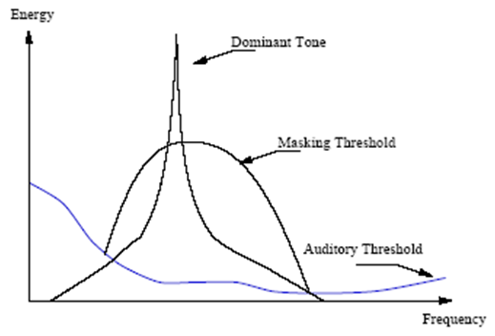
Masking
If a dominant tone is present then noise can be added at frequencies next to it and this noise will not be heard.
Coding consequences
Less precision is required to store nearby frequencies
Less precision = coarser quantization
Definitions
Auditory threshold – minimum signal level at which a pure tone can be heard
Masking threshold – minimum signal level if a dominant tone is present

Slide 15
MP3 schematic
Input: 16 bit at 44kHz sampling is 768kbit/s
Output: Coded audio signal at ~128kbit/s
Frequency analysis
similar to Fourier series
lossless compression
to be studied later
loss of information
happens here
minor extra
information
encoded here
Frequency analysis
similar to Fourier series
effects of masking
determined here

Slide 16
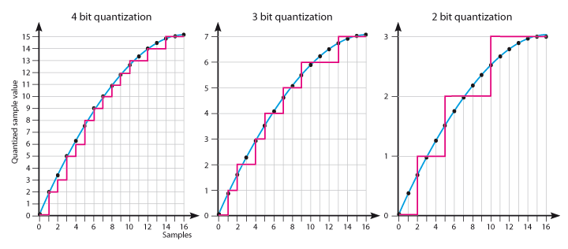
Quantization
When creating a digital representation of a sampled value, we must choose the number of bits used to represent the value.
Since fewer bits encode a smaller number of values, using fewer bits results in a larger quantization error
quantization error = difference between the actual and encoded value
We want quantization error to be small, i.e. more bits.
On the other hand, fewer bits take up less space.
sixteen possible
values
eight possible
values
four possible
values
quantization
error

Slide 17
Non-uniform quantization
MP3 compression quantizes the amplitudes of different frequency components differently, depending upon masking.
Frequency components near a dominant masker are quantized with lower bits.
Frequency analysis
similar to Fourier series
lossless compression
to be studied later
loss of information
happens here
minor extra
information
encoded here
Frequency analysis
similar to Fourier series
effects of masking
determined here

Slide 18
Summary
Audio waveforms are typically analyzed as a sequence of frames
Within each frame, the signal can be well approximated by a few frequency components
The spectrogram can be used to visualize changes in the frequency content over time
Framing is used in MP3 audio compression
MP3 audio compression combines framing and frequency analysis with a non-uniform quantization based on a perceptual model
Quantization results in loss of information
By throwing away “unimportant” (imperceptible) information, we can obtain large compression ratios.
We will study a very simple version of this idea in the lab.

