Slide 1
ELEC1200: A System View of Communications: from Signals to Packets
Lecture 12
Motivation
  Music as a combination of sounds at different frequencies
Cosine waves
  Continuous time
  Discrete time
Decomposing signals into a sum of cosines
  Amplitude Spectrum

Slide 2

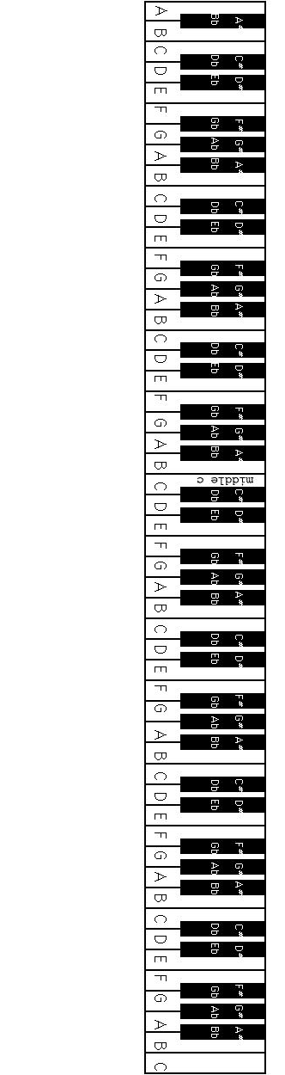
Motivation: Music
Music is a combination of sounds with different frequencies:
In this lecture, we see that this is true of any waveform
frequency = 261.63Hz (C4)
1
0
-1
0
5
10
15
20
25
30
frequency = 329.63Hz (E4)
increasing frequency
1
0
-1
0
5
10
15
20
25
30
frequency = 392.00Hz (G4)
1
0
-1
0
5
10
15
20
25
30
combination
1
0
-1
0
5
10
15
20
25
30
time in milliseconds

Slide 3
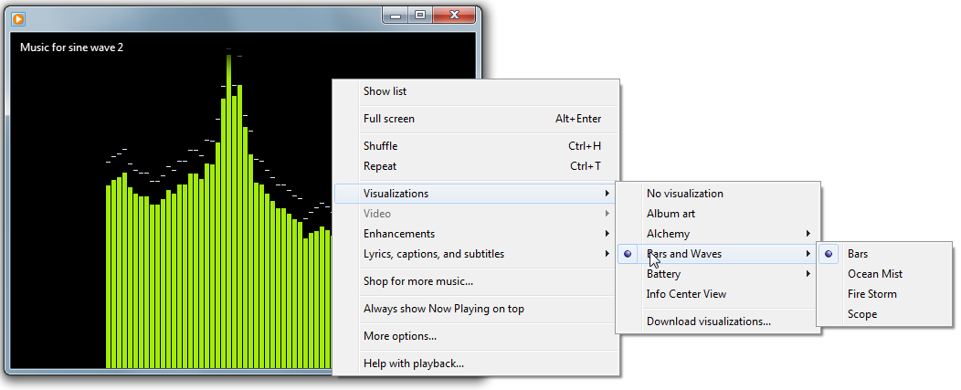
Visualizing the frequency content of music
Windows Media Player
Right click->Visualizations->Bars and Waves->Bars
amplitude
frequency

Slide 4
Sinusoidal Waves
Cosine Wave Sine Wave
Parameters:
= period (in seconds)
= frequency in hertz (cycles per second)
= frequency in radians per second
x(t)
x(t)
2
2
1
1
0
0
-1
-1
-2
-2
t (sec)
t (sec)

Slide 5
We only need cosines
A sine wave is just a cosine with a phase shift of
A negative phase shift introduces a delay of
1
0
-1
0
1
0
-1
delay
0
1
0
-1
0
1
0
-1
0
1
0
-1
0

Slide 6
General Form
Any sinusiodal signal can be expressed as

Slide 7
Discrete Time Cosines
Consider a discrete time cosine waveform with N samples:
In the following, we assume N is even.
If we have only N samples, it turns out that we only need to consider N/2+1 frequencies:
For all N, it is always true that 0 ≤ f_{k} ≤ 0.5
k indicates how many times the cosine repeats in N samples
The larger k, the higher the frequency
Different waveforms are obtained by changing the parameters A_{k} and θ_{k} in the equation
f_{k} is called a normalized frequency
It has units of cycles/sample

Slide 8
Discrete time cosines with varying f_{k}
f₁ = 1/64
1
0
-1
0
10
20
30
40
50
60
f₂ = 2/64
1
0
-1
0
10
20
30
40
50
60
f₄ = 4/64
1
0
-1
0
10
20
30
40
50
60
f₈ = 8/64
1
0
-1
0
10
20
30
40
50
n
60

Slide 9
Normalized vs continuous frequency
Given a continuous cosine of frequency and sampling at frequency F_{s}, we get a set of samples x(n):
Units of f are cycles per sample:
Conversion:
= 1Hz cosine sampled at F_{s} = 6Hz
1
T_{s}
0
-1
0
1/6
2/6
3/6
4/6
5/6
1
1.5
2
time in seconds
0
1
2
3
4
5
6
7
8
9
10
11
12
sample index
frequency in Hz
normalized frequency

Slide 10
Sinusoidal Representation of Sampled Data
Any sampled data waveform x(n) with N samples:
can be expressed as the the sum of a N/2+1 cosine waves with frequencies
using the equation
This equation is called the Fourier series expansion of x(n)
Different waveforms are obtained by changing the values of A_{k} and φ_{k}
each term in the
summation is called a
frequency component

Slide 11
Interpretation of
A_{k} controls the amplitude of the cosine with frequency f_{k}.
φ_{k} controls the phase of the cosine with frequency f_{k}.
2
large low
frequency
component,
small high
frequency
component
1
0
0
50
100
150
200
250
2
small low
frequency
component,
large, high
frequency
component
1
0
0
50
100
150
200
250

Slide 12
Amplitude, Phase and Frequency
Amplitude A_{k}
  tells us how much of each frequency there is.
  A₀ controls the average level of the signal and is sometimes called the DC component.
Phase φ_{k}
  Not so important, just shifts each cosine left or right.
Frequency f_{k}
  tells us about how quickly the signal changes
  Low frequencies (small k) indicate slow changes.
  High frequencies (large k) indicate fast changes.
We are most interested in the amplitude and how it changes with k.
  The frequency components with the largest amplitude are the “most important.”

Slide 13
Amplitude Spectrum
A plot of A_{k} versus k
Gives a graphical representation of which frequencies are most important

Slide 14
Example: Square Wave
Waveform
Amplitude Spectrum
1.5
1
1
x(n)
A₂cos(2πf₂n+φ₂)
0
0.5
-1
0
0
16
32
48
64
0
8
16
24
32
1.5
1
x(n)
A₂cos(2πf₂n+φ₂)
+A₆cos(2πf₆n+φ₆)
1
0
0.5
-1
0
0
16
32
48
64
0
8
16
24
32
1.5
1
x(n)
A₂cos(2πf₂n+φ₂)
+A₄cos(2πf₄n+φ₄)
+A₁₀cos(2πf₁₀n+φ₁₀)
1
0
0.5
-1
0
0
16
32
48
n
64
0
8
16
24
32
k

Slide 15
More Complex Example
signal
1
0
-1
n
0
50
100
150
200
250
amplitude spectrum
0.2
0.1
0
k
0
20
40
60
80
100
120

Slide 16
Transforms
The Fourier Series is only one of a set of representations (transforms) you will study later:
  Fourier Transform
  Laplace Transform
  Z Transform
Transforms are merely a different way of expressing the same data. No information is lost or gained when taking a transform.
  Loose analogy: transform ~ translation
We use transforms because
  It gives us a different way of viewing or understanding the signal.
  Some operations on signals are easier to understand/analyze after taking the transform.

Slide 17
Summary
Any signal can be expressed as the sum of cosines with different frequencies.
Cosines in discrete time use normalized frequency, which has units of cycles/sample
The amplitude spectrum
  Is the weightings (sizes) of the different frequency components, A_{k}, plotted as a function of k
  Tells us important information about what the signal looks like.
  Frequency components with the largest amplitudes are the “most important”
Knowledge of both the amplitude and phase spectrum is equivalent to knowledge of the signal.

Slide 18
Appendix: Discrete Fourier Transform (DFT)
The DFT takes a waveform x(n) and returns a set of N complex valued coefficients, called Fourier coefficients.
  The Fourier coefficients are denoted by X_{k} for k=0,1…(N-1)
  The formula (not important for this course) is
  For this course, we use MATLAB’s “fft” function to compute the Fourier coefficients.
From the first N/2+1 Fourier coefficients, we can compute A_{k} and φ_{k} for k=0,1,…(N/2)
This is the complex exponential
For more details wait until you take ELEC2100

Slide 19
Appendix: complex numbers
Define
A complex number is given by z = a+jb, where
  a is the “real” part = Re{z}
  b is the “imaginary” part = Im{z}
Since a complex number has two parts, we can represent it as a point on a 2D plane (the complex plane)
By analogy with polar coordinates, we can define the magnitude and phase.
Im z
b
a
Re z

Slide 20
Appendix: The DFT in MATLAB
The MATLAB function “fft” implements the “Fast Fourier Transform,” a fast way to compute the DFT.
>> Xdft = fft(x);
returns an N dimensional vector containing the DFT coefficients.
We need to be a bit careful with MATLAB’s indexing
  The first index of x(n) in our notation is n=0, but the first index of a vector in MATLAB starts with 1.
  Thus, if we represent a waveform x(n) for n=0,..(N-1) in a MATLAB vector x. Then,
  x(1)= x(0), x(2)= x(1),…, x(N)= x(N-1)
  Similarly,
  Xdft(1) = X₀
MATLAB
signal

